Slide 1


CURRENCY CONVERTER
PROJECT
Name – Suchika Raturi
Uni. R.No. –
Section –

Slide 2

CONTENT
01
INTRODUCTION
02
CODE IMPLEMENTATION
03
RESULT
04
FUTURE WORK

Slide 3
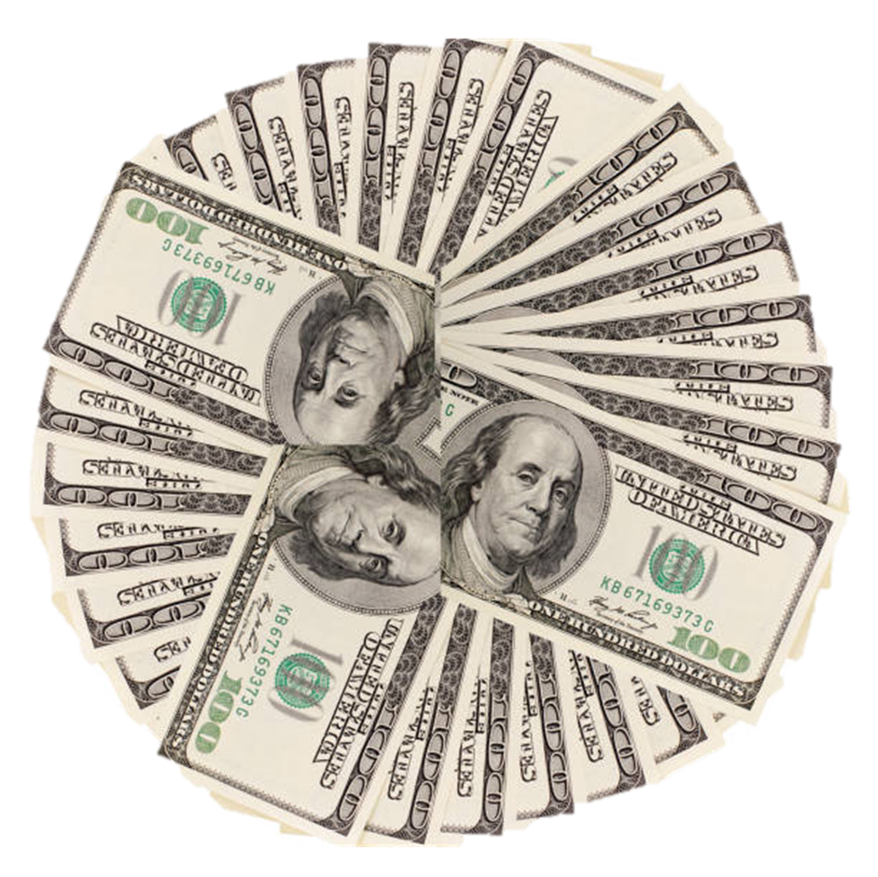

INTRODUCTION
The currency converter in Java aims to design an algorithm that is simple, less complex, high speed and efficient.
The main objective of this project is to create a “Currency Converter” so that people can easily change the amount of the currency that they want to change into another.

Slide 4
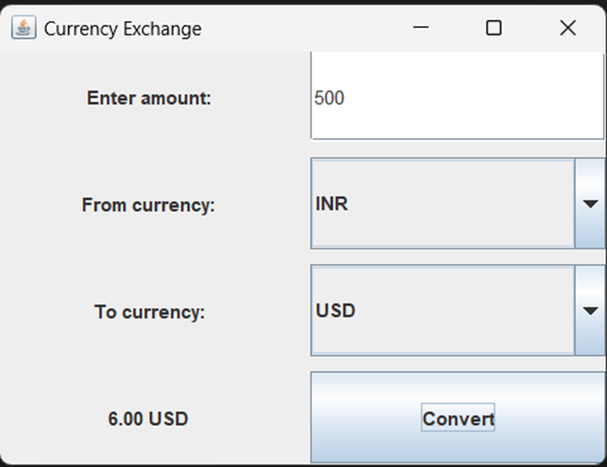
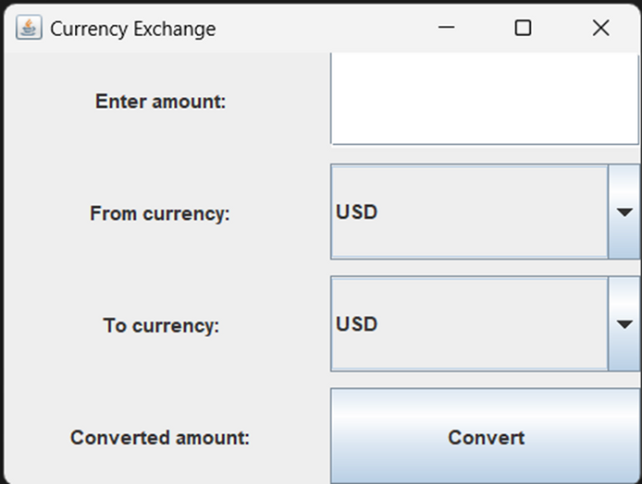
CODE IMPLEMENTATION
·GUI design : a graphical user interface for user to convert one currency to another. It contains -
1)Jframe
2)JLabel
3)JTextField
4)JComboBox
5)Jbutton
6)Jpanel
7)SwingConstants
8)GridLayout
9)ActionListener

Slide 5
CODE IMPLEMENTATION
Event Handling :It performs the conversion by clicking convert button it triggers the currency conversion process.
Logic for currency converter: Using the exchange rates of currency we can convert currencies . Get the amount from JTextField and select currency from JComboBox and calculate the converted amount.
This is a simple method to convert currency using a simple GUI application with ActionListener and integrating them together.

Slide 6
RESULT
The currency converter application developed using Java's AWT and Swing frameworks successfully meets the project objectives. The application provides a user-friendly interface that allows users to select the source and target currencies from dropdown menus and input the amount to be converted. Upon clicking the "Convert" button, the application fetches exchange rates and displays the converted amount instantly.

Slide 7
FUTURE WORK
Integrating APIs to fetch real-time exchange rates will improve the accuracy and reliability of the Currency Converter.
Enhancing the graphical user interface (GUI) with advanced features such as dynamic dropdown menus with autocomplete functionality for currency selection will enhance user experience.
Implementing a feature such that it contains local language which will broaden the application's usability on a global scale.

Slide 8

THANKYOU

